Slide 1
NETW211 Course Project Module 6 Cloud Monitoring Edward Alvarado March 2022

Slide 2
Rubric
Activity | Requirement(s) | Points
Setting up an Action Group and Notifications | Screenshot | 20
Setting up Alert Rules | Screenshot | 20
Testing Alerts | Two screenshots | 20

Slide 3
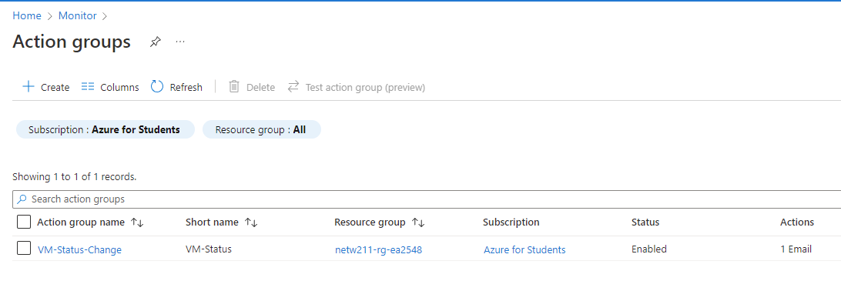
Setting up an Action Group and Notifications
This screenshot should show the “VM-Status-Change” action group on the Manage actions page.

Slide 4
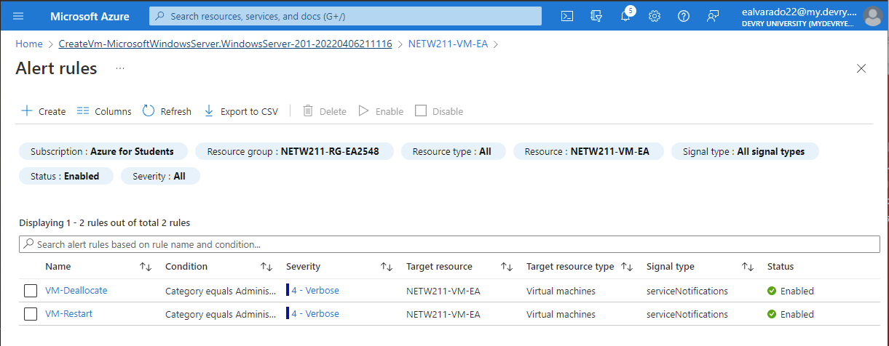
Setting up Alert Rules
This screenshot should show the Alert rules window showing the VM-Deallocate and VM-Restart rules.

Slide 5
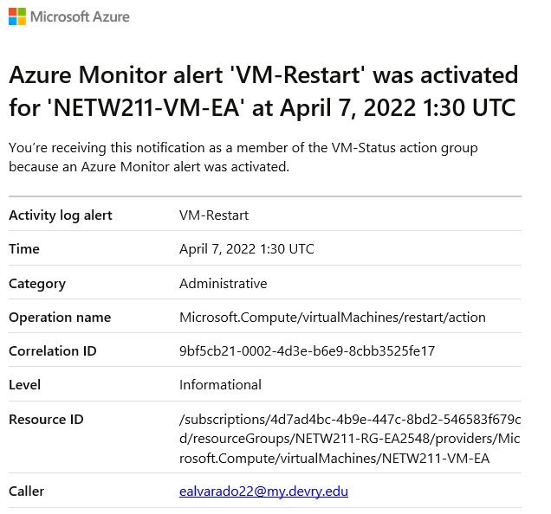
Testing Alerts
This screenshot should show the ‘VM-Restart’ was activated email message with the date and time of the alert.

Slide 6
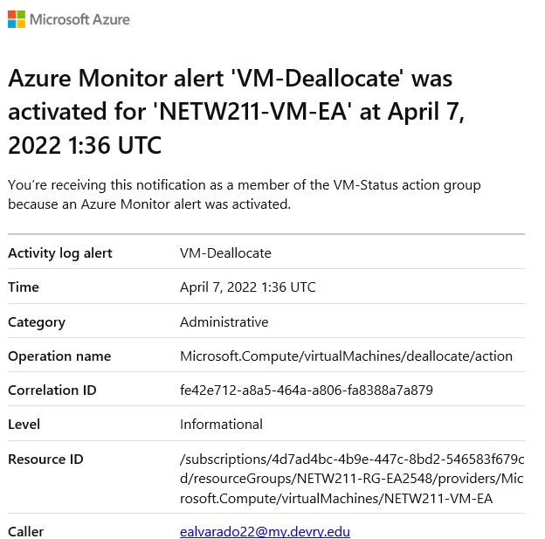
Testing Alerts cont’d
This screenshot should show the ‘VM-Deallocate’ was activated email message with the date and time of the alert.

